Slide 1
Addressing the Access to Justice Imperative The Role of Regulatory Innovation
Ellyn S. Rosen Regulation and Global Initiatives Counsel ABA Center for Professional Responsibility
Zack DeMeola Director of Strategic Initiatives LSAC

Slide 2
What are we really talking about here?
Setting the table…

Slide 4
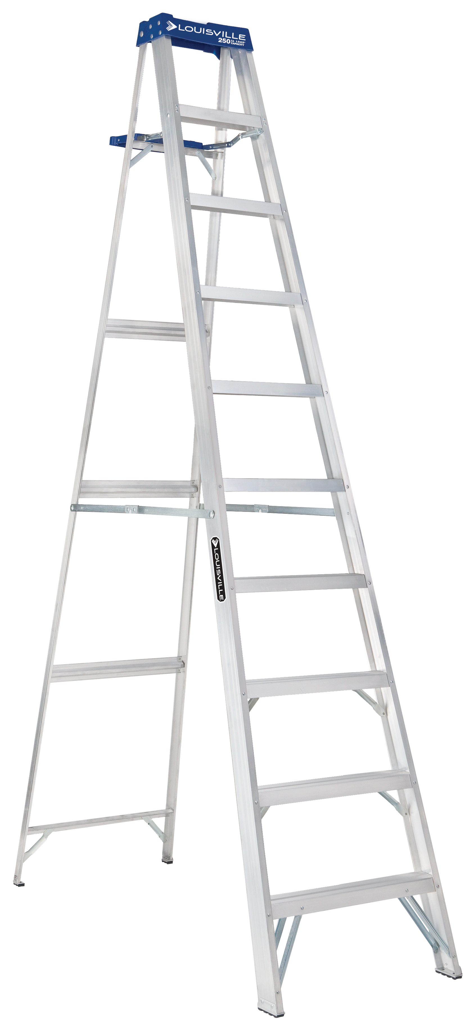
People in Need: Way Up the Income Ladder
IAALS Justice Needs (2021)
Broad societal problem. Impacts people from all walks of life.
66% experienced at least one legal issue in the past four years, with just 49% of those problems having been completely resolved.
NCSC Landscape of Civil Litigation in State Courts (2015)
76% of all non-domestic civil cases in state courts involve at least one self-represented party
90% and more for eviction and debt collection (mainly defendants).
Upwards of 80-90% of family law cases involve at least one unrepresented party
64% of caseload are contracts cases (debt collection/eviction). Only 7% of caseload are tort cases.
LSC Justice Gap Report (2017)
86 % of civil legal problems reported by low-income Americans in the prior year received inadequate or no legal help

Slide 5
Public Trust & Confidence
Public Perceptions of Trust and Confidence (IAALS, 2020)
Majority of participants expressed concerns about the fairness of the current civil process, citing:
systemic racial or gender bias
differential treatment based on financial ability
judicial biases
Justice Needs (IAALS, 2021)
In fact, lower income, women, multiracial and Black Americans (among others) are particularly vulnerable in terms of nature, seriousness, and resolution rates of legal problems

Slide 6
Racial (in)Justice
Uneven Starting Points
Typical black versus white household median net worth: $11,000 versus $141,900 (Pew, Wealth inequality has widened along racial, ethnic lines since end of Great Recession, 2014)
Black Americans Disproportionately Face Evictions
21% of all renters
35% of all defendants in eviction cases (Eviction Lab at Princeton University, Racial and Gender Disparities among Evicted Americans, 2020)
Black Americans Disproportionately Affected by Debt Collection
From 2010 to 2019, more than 90% of defendants in debt collection cases had no lawyers
Plaintiffs win over 95% of debt collection suits
More than 70% result in default judgments (Pew, How Debt Collectors Are Transforming the Business of State Courts (May 2020)
Rate of debt collection judgments against defendants twice as high in black neighborhoods as in white (Pro Publica, The Color of Debt: How Collection Suits Squeeze Black Neighborhoods, 2015).

Slide 7
Traditional Solutions
Pro Bono
$46.5 billion for one hour to all households with legal problems.
180 pro bono hours for every single licensed lawyer in U.S.
Current average is 55 hours, but only among 52% who provided such services
Hadfield & Rhode, How to Regulate Legal Services to Promote Access, Innovation, and the Quality of Lawyering (2016)
“The federal appropriation for the Legal Services Corporation, the country's largest funder, amounts to less than what Americans spend every year on Halloween costumes…for their pets.”
-Jim Sandman, President Emeritus, LSC
Legal Aid
Notes:
What about pro bono hours? According to economist and law professor Gillian Hadfield, Hadfield looked at what it would cost to fix all these problems. The average hourly rate of a noncorporate lawyer is $200–$250. Therefore, at $200 an hour (on the conservative side of this range), it would cost $46.5 billion to provide just one hour of legal help to all the households in America currently facing legal problems. If every single one of the 1.3 million licensed lawyers in the U.S. were to take on all these problems, they’d each have to put in 180 pro bono hours. The current average amount of pro bono hours is 55, but that is among the 52 percent who provided such services in 2016—a far cry from the 100 percent participation rate we would need to address these problems fully. What about funding for legal services or self-help? The resources currently available—including pro bono work, legal aid, and self-help resources—are simply not able to meet the legal needs of those who cannot afford an attorney.

Slide 8
A Dysfunctional Market: Lawyers Struggle
Big law firms do ok. They don’t serve individual people, they serve corporations, and they have work-arounds. But they face increasing competition - ALSP market grew from $8.4 billion in 2015 to $10.7 billion in 2017, an annual growth rate of 12.9.% (William D. Henderson, Legal Market Landscape Report, 2018)
Lawyers who serve people have seen a remarkable market contraction.
Market shrank by nearly $7B (about 10%) between 2007 and 2012, while total lawyer pop. increased. (William D. Henderson, Legal Market Landscape Report, 2018).
1,300 counties in the U.S. had less than one lawyer per 1,000 residents & almost every state has counties with few or no lawyers (ABA Profile of the Legal Profession 2021)
CLIO data suggests many lawyers are scraping by. In 2020, the average lawyer billed just 2.5 hours of an 8-hour day. (Clio Legal Trends, 2021)
75% of civil judgments in state court worth $5,200 or less. It makes little economic sense to employ full-service counsel in those cases. (NCSC Landscape of Civil Litigation, 2015)

Slide 9
Access to What?
Courts & Lawyers see a fraction of people’s actual justice problems 14-24% (Bill Henderson, Rule Makers versus Risk Takers (140), Legal Evolution (Mar. 15, 2020))
People went to lawyers for help or considered doing so with only 16% of the situations they encountered (Sandefur, Accessing Justice in the Contemporary US, 2014)
“Americans do not take most of their justice situations to lawyers or courts for another very important reason: they do not understand these situations to be legal.”
A court decided legal problem for 12% of respondents (IAALS, Justice Needs, 2021)
12% of respondents relied on lawyers for help with legal problem (IAALS, Justice Needs, 2021)

Slide 10
The market lawyers are serving now
People in need of solutions
Lawyers offering discrete services
Allied legal professionals
Lawyer assisted tools
Community-based assistance
People in need of financial subsidy & legal aid

Slide 11
Access Ecosystem
Access to Justice
Full & Fair Resolution of Problems
Access to Legal Services
Access to Courts

Slide 12
Constricted Resources & the Need for Innovation
Legal Advice
Easy to Use Tools
User- Centered Solutions
Legal Services
Bottleneck

Slide 13
How Do We Create Solutions?
Our Current System Was Not Designed for Today’s Reality ... We have to think differently.

Slide 14
Values Driving Innovation Today
Serving & Protecting the Public Interest
Consumer Needs
Data Driven Policy
Dynamic and Adaptable Regulation
Accountability and Transparency

Slide 15
Areas of Regulatory Innovation & Reform in North America
Service Providers (Independent Allied & Paraprofessionals)
Authorizing and Regulating Paraprofessionals to Provide Legal Services
Innovation, Investment, & Scalability (Entity Regulation & Rule Reform)
Adjusting Ethics Rules on Prohibited Fee Sharing
Regulatory Framework
Legal Laboratories & Regulatory Sandboxes for Data Driven Outcomes
Dynamic Risk-Based Regulation
Multi-Disciplinary Professional Regulators & Service Providers
Exploring Other Exceptions to UPL (Limited Services Providers)
Create tiered legal services in terms of cost and complexity
Modifying/Eliminating Rules Restricting Advertising/Client Connections
New Rules Regarding Permissible Business Structures

Slide 16
Who is Leading Regulatory Innovation?
State Supreme Courts
Bar Organizations

Slide 17
What are the Major Challenges?
Obstacles to introducing regulatory innovation

Slide 18
Perspectives & Players
Legal Community (Private Practice & Non-Profit/Legal Aid)
Leadership
State Supreme Court
Other Stakeholders
Political
Skepticism of Lawyers
State Bar Organizations
Consumer Voices & Outreach
Legislative Bodies (structure of regulatory scheme)
Education
New Ways of Thinking
Inertia of Tradition
Legal Tech & Startup Communities
Scarcity Mindset
Lack of Data
Research & Policy Institutes
Law Schools

Slide 19
Tailored Solutions
One Size Does Not Fit All

Slide 20
Where Innovation is Happening Now
States that have implemented reform
States that are in the process of implementation
States with recommendations pending approval
States with pending recommendations
States that are starting the reform process

Slide 21
Authorizing & Regulating Paraprofessionals
Arizona: Legal Paraprofessional (LP)
Family law, state admin law, limited jurisdiction civil/criminal (no jail time)
Prepare and file documents, provide advice in certain situations, represent clients in hearings, negotiate legal rights
Utah: Licensed Paralegal Practitioner (LPP)
Family law, debt collection, forcible entry/detainer
Interview, fill and file forms, review docs, inform and counsel in mediation, complete settlement agreement, explain court orders

Slide 22
Other Limited licensing Models
North Carolina
AZ/UT Model of Limited Licensed Paraprofessionals
Minnesota Legal Paraprofessional Pilot Program
Attorney supervision; landlord-tenant and family law
California Recommendation
Collateral criminal matters (expungement); consumer debt; name change; employment and income maintenance; family, children and custody; and housing
Limited ability to represent clients in court
Colorado Licensed Legal Paraprofessionals
Domestic relations limited to $200,000 net marital assets
Services delivered in a law firm or in a paralegal firm
Illinois Recommendation
Designated legal areas with high unmet need, lawyer supervision
Oregon Legal Paraprofessional
Landlord-tenant and family law

Slide 23
Other Solutions with Allied Professionals
Washington: Limited Practice Officer (LPO) for transfer of real or personal property
AZ: Legal Document Preparer (LDP)
CA: Legal Document Assistant (LDA)
Federal Context
Social services professionals already trained to work with trauma victims:
Arizona: Domestic Abuse Cases
Utah: Medical Debt Collection
New York: Proposal for Social Workers & Expanded Court Navigators
Illinois: Proposal for Community Justice Navigators
Delaware: Qualified Tenant Advocates permitted to represent residential tenants in eviction cases free of charge.

Slide 24
A Tale of Two States Entity Regulation and Comprehensive Reform
UTAH
ARIZONA
Licensed Document Preparers (LDP)
Domestic Violence Pilots:
Licensed Legal Advocates (LLA)
Licensed Document Preparers (DVLDP)
ABS Regulation
Lawyers required
Only Those Licensed to Practice Law May Provide Legal Services
State Bar as Regulator
ODR
Regulatory Sandbox:
Lawyers & Others
New Regulator: Office of Legal Services Innovation
Risk based, not rule based
Rule Revisions
Advertising
Referral fees
Rule 5.4
Entity Regulation
Limited Licensed Paraprofessionals

Slide 25
Arizona Entity Regulation - Alternative Business Structures (ABS)
ABS Legal with other professionals who have an economic interest or decision-making authority
Certification for ABS entity through Supreme Court – Committee on ABS issues Recommendations
Only those licensed to practice law may provide legal services in ABS
Discipline delegated by supreme court to state bar process
Lawyer participation required

Slide 26
Arizona Authorized Entities 17 as of February
Technology & Remote Services
Wall & Olson LLC
Secure, remote online legal services
Mass torts, veterans’ rights, and sexual abuse cases
Modeled after the Air Force JAG Corps remote law firm
Esquire Law, LLC
Personal injury & workers compensation law
Proprietary technologies to improve client experience and outcomes
Esquire may also license its technologies to other law firms
Esquire anticipates that outside investment in Esquire Holdings, LLC will be used to continue to develop its technologies

Slide 27
Arizona Authorized Entities
Lawyers & Tax/Accounting
Trajan Estate, LLC
Payne Huebsch, PLC
Provides transactional legal services combined with tax and accounting advice. It is owned by a lawyer and a CPA.
A legal service provider focused on estate planning.
Principles: Arizona lawyer and CEO of Trajan Wealth.

Slide 28
Sandboxes: Legal Laboratories
A New Type of Pilot Project
A tool to collect data and test processes, procedures, or technologies
How is a Sandbox Different?
Scope
Pilot projects are initially limited: a few local courts.
Sandboxes contemplate statewide rollouts
Duration
Pilot projects are shorter than sandboxes

Slide 29
Sandboxes: Legal Laboratories
What can a sandbox do?
Erecting a regulatory sandbox does not by itself create reform. The sandbox is a tool only, an environment for experimentation
The real commitment comes in erecting the structures for management and evaluation of the sandbox once experimentation begins
There must be a commitment to collect and analyze data

Slide 30
Sandboxes: Legal Laboratories
Utah, NC, British Columbia: risk-based assessment by independent regulator
Law Society of Ontario: Requires a tech component
Law Societies of Alberta & Saskatchewan: identify benefit to the public
Washington: online legal services and alternative business structures; enhanced access to justice as a requirement for participation; participation fee of $3,000 to $5,000
Chicago Bar Foundation: Authorize lawyers to participate as owners of, employees of and advisors to Approved Legal Technology Providers

Slide 31
The Utah Model: Process
Applicants tell the regulator what they are proposing
Applicants tell the regulator what kinds of risks there might be for consumers in the proposal
Regulator makes recommendations to the Court – the Court decides whether to authorize
Sandbox participant reports required data and makes required consumer disclosures
Regulator watches for harm and takes necessary steps to address

Slide 32
Utah Authorized Entities 35 as of Jan. 2022
1Law
Law firm using software platform and chatbot, nonlawyer providers, and lawyers in tiered - service system. Accident, Injury, Employment, Immigration, Marriage & Family, etc.
HelloDivorce:
Company majority-owned by a lawyer offering dissolution of marriage services through tech platform and lawyer employees.
Davis & Sanchez
Alternative business structure offering workers’ compensation services. Davis, a lawyer, sought authorization to sell the firm to his son-in-law, who has run business operations for the firm for 10 years and is not a lawyer.
AAA Fair Credit Foundation with Peoples Legal Aid
Partnership AAA Fair Credit and People's Legal Aid to offer legal assistance related to medical debt through nonlawyer subject matter experts assisting in debt negotiation, advising, and form completion.

Slide 33
The Importance of Data & Empirical Evidence
How to measure improvements in innovation and access

Slide 34
Challenges

Slide 35
What do we know now?
What have we learned from the data we have?

Slide 36
Arizona
No Complaints of any ABS entities to date

Slide 37
Utah Sandbox Data (Jan. 2022)
35
Authorized Entities
~10,000
Unduplicated Clients
15,438
Legal Services Sought
14, 464
Legal services delivered by lawyer/lawyer employee or software/other professional) + lawyer involvement
4
Harm related complaints
1:3860
Ratio of harm related complaints to services delivered

Slide 38
Minnesota
Interim Report and Recommendations to the Minnesota Supreme Court December 27, 2021
9 paraprofessionals
75% family law cases and 25% housing cases
50% of clients would have been unrepresented without the assistance of the legal paraprofessional
>50% of paraprofessionals charged for their services
Those who did not charge provided pro bono services or are affiliated with legal aid offices
8 supervising attorneys
Legal paraprofessionals are “careful, serious, and excellent”
No complaints about the legal paraprofessional’s performance in court or with how they managed cases

Slide 39
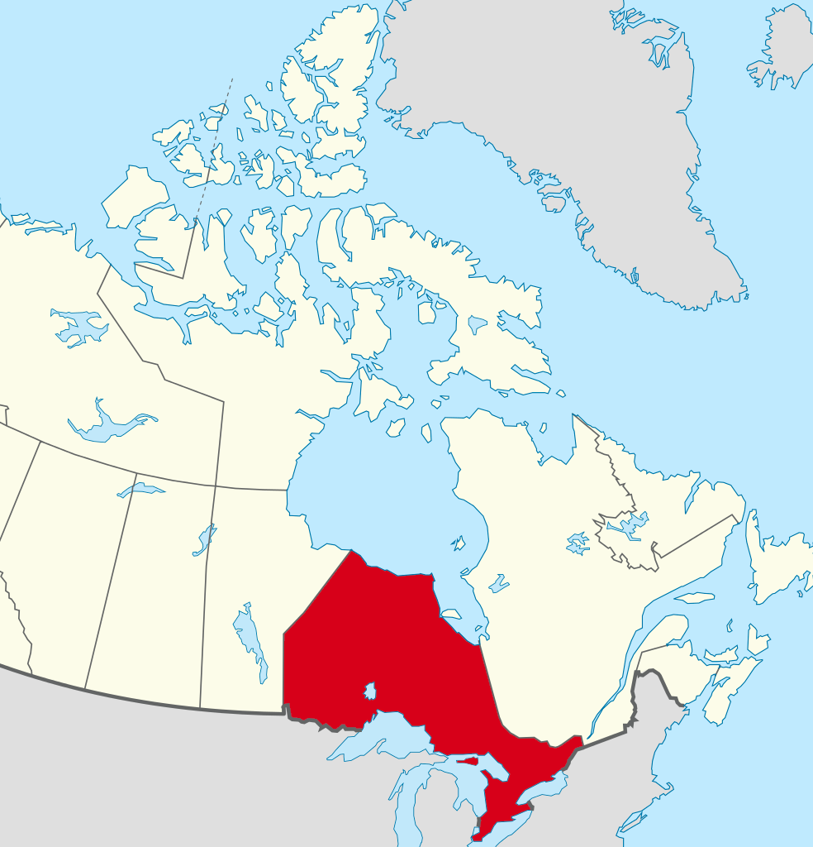
Outcomes: Quality Vs. Harm
Paralegal services in Ontario
Same rate of disciplinary action as lawyers
87% would use paralegal service again.
79% believed paralegal behaved professionally
74% of clients were satisfied or very satisfied
68% reported that services were good value
Morris Report Five Year Review (2012)

Slide 40
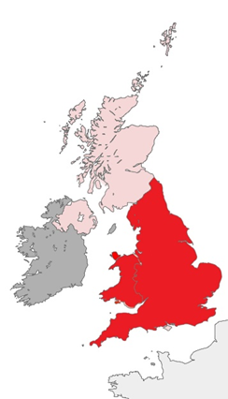
Outcomes: Quality Versus Harm
No increase in complaints or discipline in England & Wales and Australia for ABS model
The LSB found that the quality of legal services improved, as measured by the 12% increase in the number of “first tier” complaints being resolved. The report noted that new business models, including ABSs, have better and more responsive consumer complaint processes
ABSs were 13-15% more likely to introduce new legal services in England & Wales, resulting in improved access, choice, and quality of service (Centre for Strategy & Evaluation Services)

Slide 41
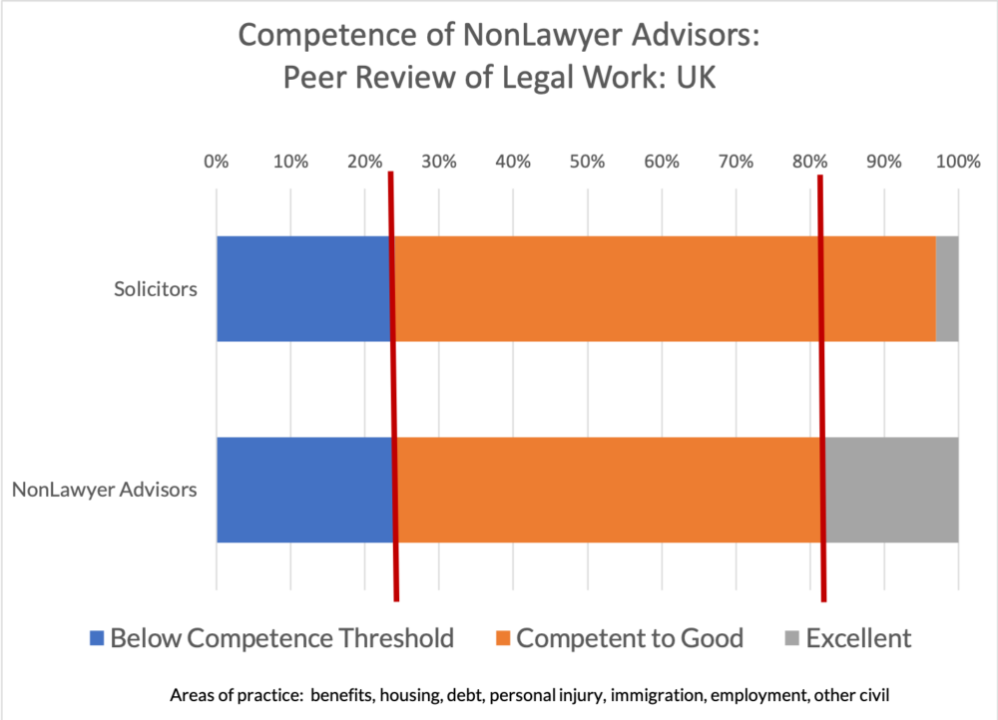
Sandefur, “Legal Advice: Consumer Demand, Nonlawyer Competence, & Public Harm,” 2020 AALS Annual Meeting (citing Moorhead et al, Quality and Cost: Final Report on the Contracting of Civil, Non-Family Advice and Assistance Pilot. London:TSO, 2001, tbl. 5.6).

Slide 42
Questions?

