Slide 1
Thriving After COVID:
The Silver Lining of Change
By Patrick Palace
@PalaceLaw
Patrick@PalaceLaw.com

Slide 4
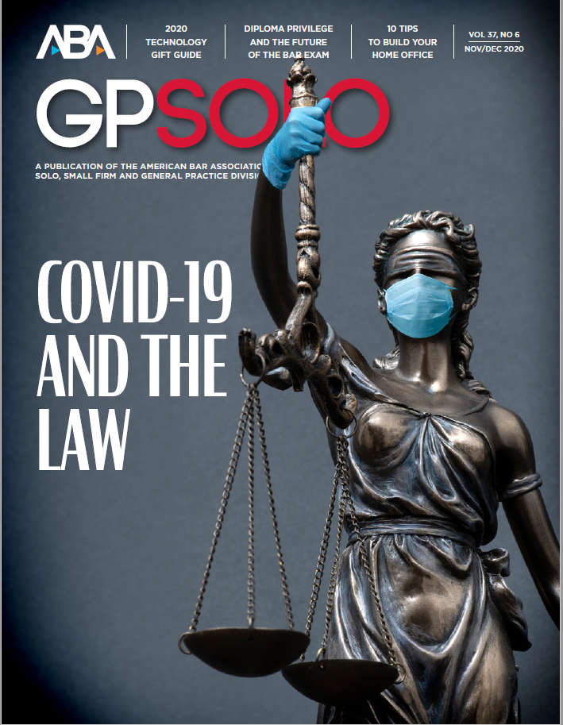
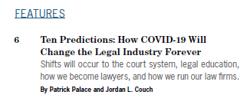

Slide 5
2020

Slide 7
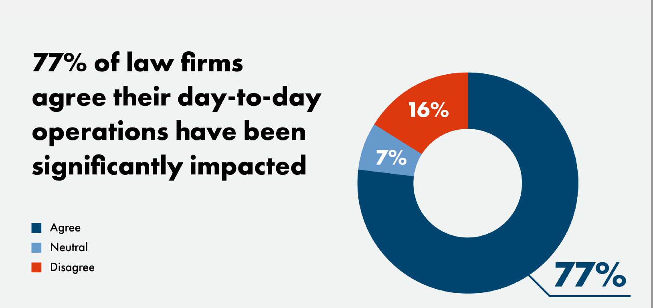
2020

Slide 8
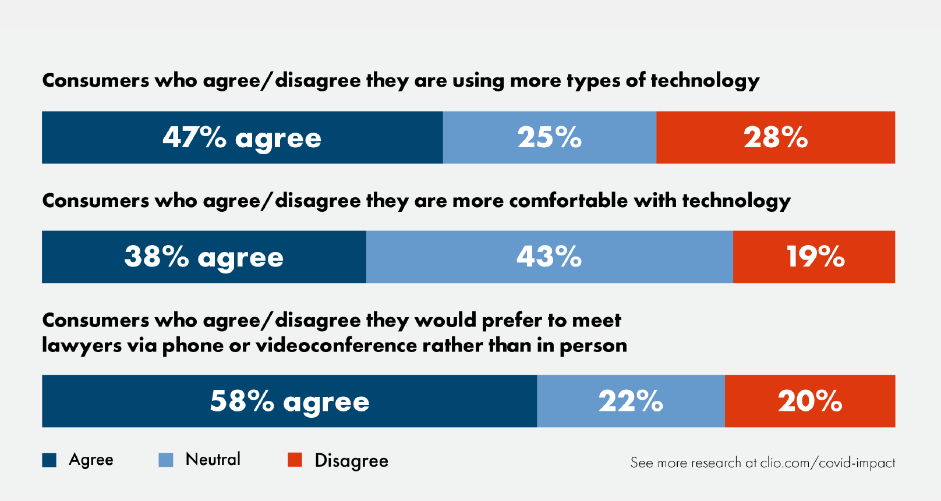
2020

Slide 9
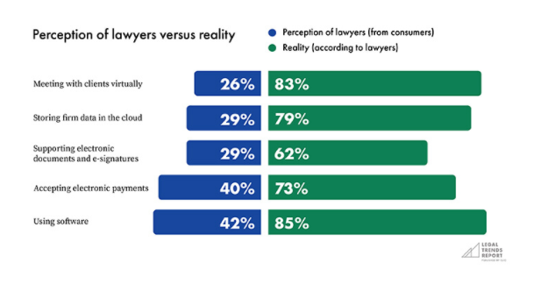
2020

Slide 10
Prediction #1
THE EXPANSION OF REMOTE WORK

Slide 13
Prediction #5
clients never want to see your lobby again

Slide 16
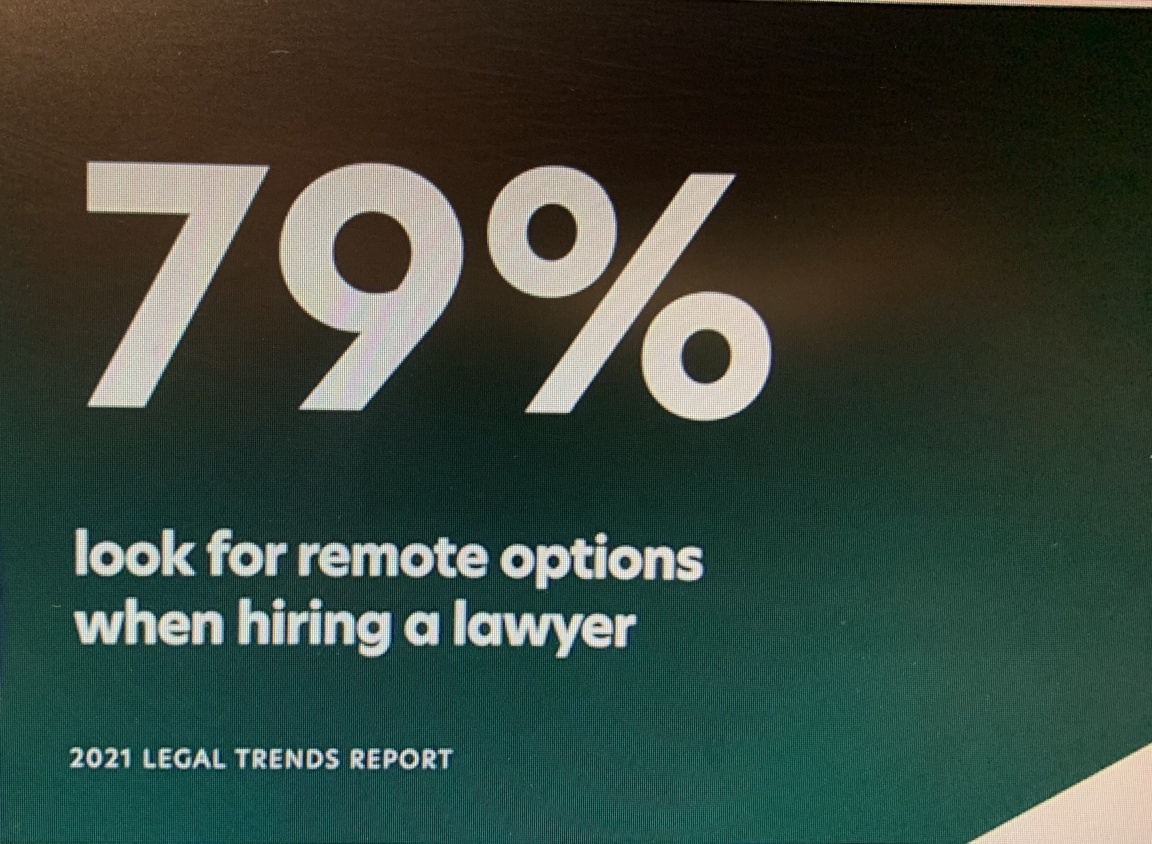

Slide 17
Prediction #4
improved business practices

Slide 18
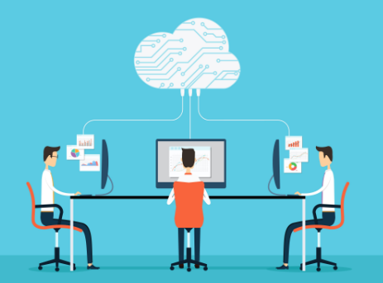
SYSTEMS

Slide 20
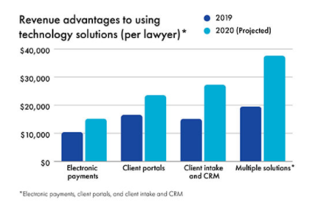

Slide 21
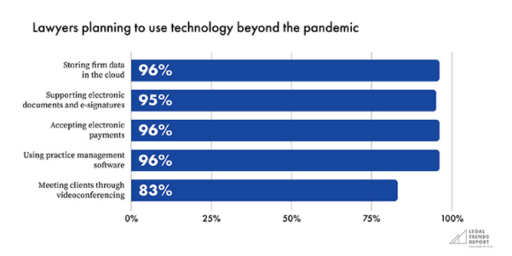
2020

Slide 22
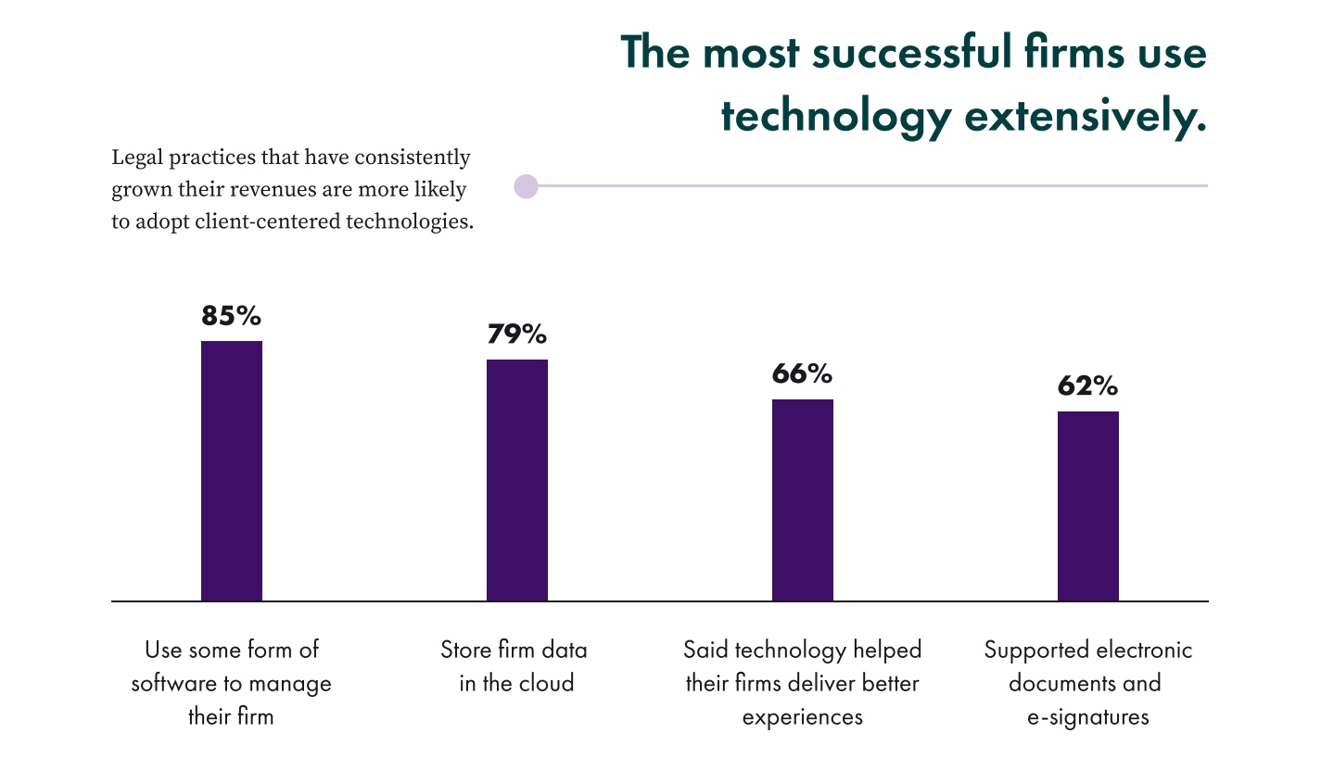
2021

Slide 24
Prediction #6
rent as unnecessary overhead

Slide 25
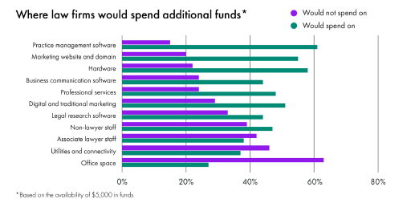
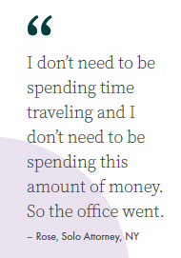

Slide 27
7 areas of law that grew dramatically during COVID
Bankruptcy and restructuring
Criminal defense
Intellectual property
Labor and Employment
Litigation
Commercial and residential real estate
Trust and Estate work

Slide 28
SILVER LINING OUTCOMES
Employment is up IN 2020
Revenue is up 11%-16%
GLOBAL MERGER UP 143%
Lawyers are no longer late tech adopters
MORE FLEXABLE service to clients
ABILITY TO Serve more clients
Better life balance

Slide 29
Thriving After COVID:
The Silver Lining of Change
By Patrick Palace
@PalaceLaw
Patrick@PalaceLaw.com

