Slide 1
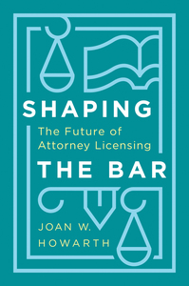
Evidence-Based Licensing Mar. 31, 2023 Joan W. Howarth
Distinguished Visiting Professor, Boyd School of Law, UNLV Dean Emerita, Michigan State University College of Law Member, Nevada Board of Bar Examiners (2020 to present) joan.howarth@unlv.edu
drawing on: Shaping the Bar: The Future of Attorney Licensing (Stanford Univ. Press 2023)

Slide 2
Joan W. Howarth, Shaping the Bar: The Future of Attorney Licensing (Stanford University Press 2023)
Part I: The Attorney Licensing Crisis and How We Got Here
1 The Crisis in Attorney Licensing
2 Becoming a Lawyer in the Young Nation
3 Shaping the Bar in the Twentieth Century
4 The 1970s Legacy of Activism, Psychometrics, & Good Faith
5 Pressure Points in Contemporary Licensing
Part II: Slouching Towards Minimum Competence
6 Decades Lost Without Research
7 Doubling Down on the Errors of Legal Education
Finally, Research on Minimum Competence
Part III: Character and Fitness: The Right Stuff
9 Who Fits?
Fixing Character & Fitness
Part IV: The Future: Competence-Based Alignment of Experience, Education, and Exams
11 Twelve Guiding Principles
12 Clinical Residencies
13 Educational Requirements
14 Escaping the Conceptual Traps of Today’s Bar Exams
15 Bar Exams: Better, Best, and Other Fixes

Slide 3
The pandemic shook up the world.

Slide 4
How do we license in a pandemic?

Slide 6
How should we license?

Slide 7
2020
pandemic shook us up
research gave us a new solid foundation

Slide 8
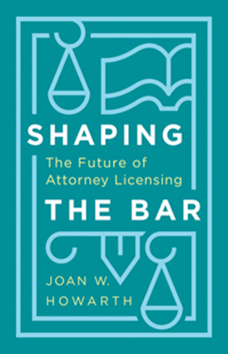
Shaping the Bar
Table of Contents
Part II: Slouching Towards Minimum Competence
6 Decades Lost Without Research
7 Doubling Down on the Errors of Legal Education
8 Finally, Research on Minimum Competence

Slide 9
California State Bar Commission to Study the Bar Examination Process (1975)
Commission Member Robinson explained why the Commission “did not attempt to determine whether the bar [exam] is job related.”
“We just didn't know how to do it.”
He added,
“Hopefully one of these days somebody will come up with the answer to that.”
(David K. Robinson (L.A. Bar Assn.), remarks at UCLA Black Law Journal Symposium 1976).

Slide 10
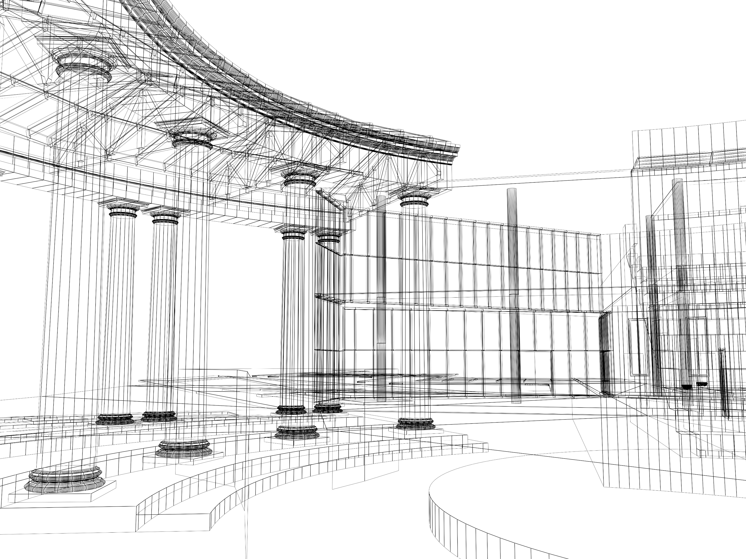
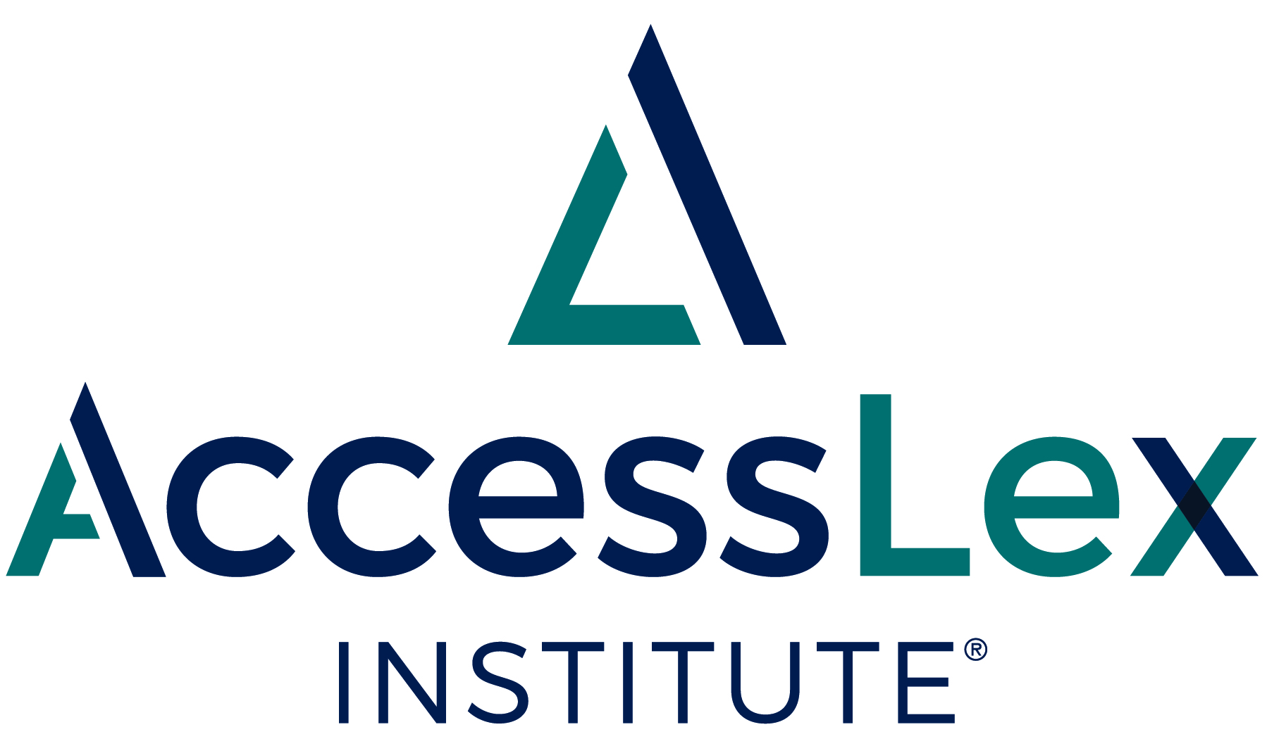
Building a Better Bar
Deborah Jones Merritt & Logan Cornett

Slide 11
Merritt & Cornett, Building a Better Bar (2020)
50 Focus Groups
18 Locations Nationally – Including Urban and Rural Areas
New Lawyers and Supervisors
Diverse Demographics and Practice Settings
Best Practices for Focus Group Research
More Than 1500 Pages of Transcribed Discussion

Slide 12
Building a Better Bar findings about New Lawyers
They use state/local law more often than federal law
Many engage directly with clients
Many take primary responsibility for client matters
They struggle to learn skills in the workplace
They do not rely upon memorized rules
Care and preparation matter more than speed

Slide 13
CLIENT RESPONSIBILITY from DAY ONE
“As a first year associate I was a major point of contact for most of my clients, which surprised me . . . . Being able to talk to the CFO of a big company was not something I expected but I had to develop that skill really quickly.”
Transactional Associate, Firm of 501+ Lawyers (Corporate Finance)

Slide 14
“I walked in on my first day, we weren’t even barred yet. I think they were billing me as a paralegal at the time, and they handed me 40 cases and said ‘go.’ There was no instruction.”
Litigation Associate, 11-50 Lawyer Firm

Slide 15
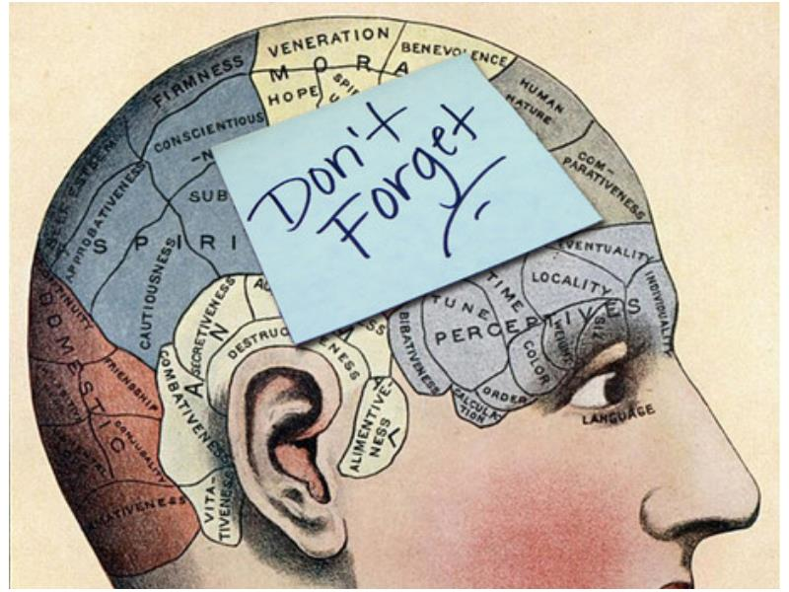
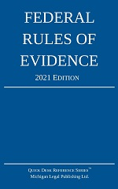
Relying on memory is “a bad way to practice law.”
It’s “malpractice.”
“Read the rule before you give an answer.”
“I often am reminding new lawyers that there’s a rule book that they should look at.”
“We had a saying, ‘why look it up when you can speculate?’ Which is to say we looked everything up.”

Slide 16
New Lawyers Rely Upon Threshold Concepts
Insights that transform understanding
Often counterintuitive
Permanently change view of a subject
Distinguish experts from the uninitiated

Slide 17
Threshold Concepts v. Detailed Rules
At a defendant’s trial for extortion, the prosecutor called a witness expecting her to testify that she had heard the defendant threaten a man with physical harm unless the man-made payoffs to the defendant. The witness denied ever having heard the defendant make such threats, even though she had testified to that effect before the grand jury. The prosecutor now seeks to admit the witness’s grand jury testimony for the truth of the matters asserted there.
How will the court rule with regard to the grand jury testimony?

Slide 18
Threshold Concepts
Evidentiary rules exclude most out-of-court statements offered to prove the truth of the matter asserted (“hearsay”) because in-court statements are more likely to be truthful.
The rules admit some out-of-court statements, but only under very specific circumstances (exceptions).

Slide 19
Threshold Concepts
Rules
A witness’s out-of-court statement is admissible if (a) it is inconsistent with the witness’s courtroom testimony; (b) the witness is subject to cross-examination, and (c) the prior statement was made under penalty of perjury at a trial, hearing, or other proceeding or in a deposition.
A grand jury proceeding counts as an “other proceeding.”

Slide 20
Care and Preparation Matter More Than Speed
“Most of the big mistakes we make are created by time pressure, people get in a hurry. They get careless.”
Some new lawyers “rush through things and that’s where the mistakes are made.”
New lawyers should “slow down” because “I’d rather have the quality work, not the quantity.”
“I’ve never hired someone because they’re very fast at answering 60 questions. . . . Some people process information more slowly and that’s okay.”

Slide 21
Skills Matter More Than Doctrine
Skills allow lawyers to find doctrine
New lawyers who take responsibility for client matters need a full range of lawyering skills
It’s easier to learn new doctrine as a new lawyer than new skills.

Slide 22
Twelve Building Blocks

Slide 23
Act professionally
Understand legal processes and sources of law
Understand basic concepts of legal doctrine
Interpret legal materials
Interact effectively with clients
Identify legal issues
Conduct research
Communicate as a lawyer
See the “big picture” of client matters
Manage a law-related workload
Cope with the stresses of legal practice
Pursue self-directed learning

Slide 24
Act professionally
Understand legal processes and sources of law
Understand basic concepts of legal doctrine
Interpret legal materials
Interact effectively with clients
Identify legal issues
Conduct research
Communicate as a lawyer
See the “big picture” of client matters
Manage a law-related workload
Cope with the stresses of legal practice
Pursue self-directed learning

Slide 25
Building a Better Bar 2 more studies

Slide 26
AccessLex Institute, Analyzing First-Time Bar Exam Passage on the UBE in New York State (May 2021).
Almost 5,500 respondents (40% response rate)
Grads who had greater financial resources were significantly more likely to pass
Grads who purchased commercial bar courses were also significantly more likely to pass
Grads who worked for pay were significantly less likely to pass
After controlling for LSAT, etc.

Slide 27
a recent study conducted on the efficacy of bar exams
Steven Foster, Does the Multistate Bar Exam Measure Minimum Competence? 82 Ohio St. L.J. Online (2021).
16 licensed lawyers took a simulated MBE without prep
None passed
Best score = 52% correct

Slide 28
Recommended reading:
Deborah Jones Merritt & Logan Cornett, Building a Better Bar: The Twelve Building Blocks of Minimum Competence (2020),
https://iaals.du.edu/publications/building-better-bar
Joan W. Howarth, Shaping the Bar: The Future of Attorney Licensing (2023), https://www.sup.org/books/title/?id=32230

Slide 29
Bar leader fueled by research about minimum competence.

Slide 30
Thank You!
Joan W. Howarth, Shaping the Bar: The Future of Attorney Licensing (Stanford University Press 2023)
joan.howarth@unlv.edu

