Slide 1
EFFECTIVE USE OF

Slide 2
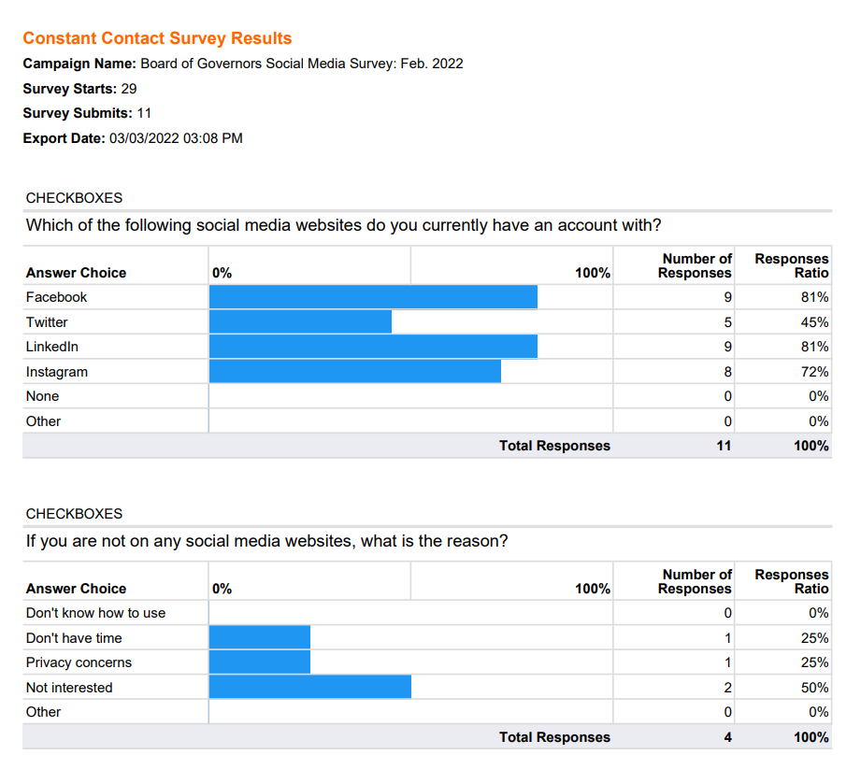
Who Uses Social Media?
Recent BOG Survey
11 of the current BOG members use it

Slide 3
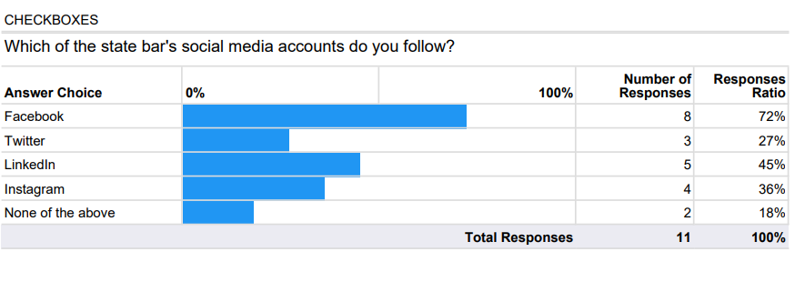
BOG Use: Personal or Professional?
Do you pass on information about the State Bar of Nevada, the BOG, SBN events, CLEs or anything concerning the practice of Law?
Do you share tags?

Slide 4
266 SOCIAL MEDIA PLATROFMS AVAILABLE
Ranging from “23 Snaps” (parents save photos, videos and measurements of their kids and stories) to “zoo.gr” (Greeks).
Most popular social media platforms :
Facebook - over 2.9 billion users
Instagram - 1.4 billion users
Twitter – 436 million users
TikTok - over 1 billion users
YouTube – 2.5 billion users
WeChat -1.26 billion users
WhatsApp - 2 billion users
LinkedIn – 810 million

Slide 5
SOCIAL MEDIA STATE BAR OF NEVADA USES
The State Bar of Nevada currently has approximately 9,200 active bar members and uses 4 Social Media Platforms:
Facebook 1,774 Friends
Instagram 313 posts/338 Followers/34 Following
LinkedIn 1,733 Followers
Twitter 2,953 Followers/156 Following

Slide 6
WHICH SOCIAL MEDIA SITES I USE
Instagram – Personal/Professional – 459 Followers/574 Following
LinkedIn – Professional only – 1,105 Followers
Facebook – Personal/Professional – 1,072 Friends

Slide 7
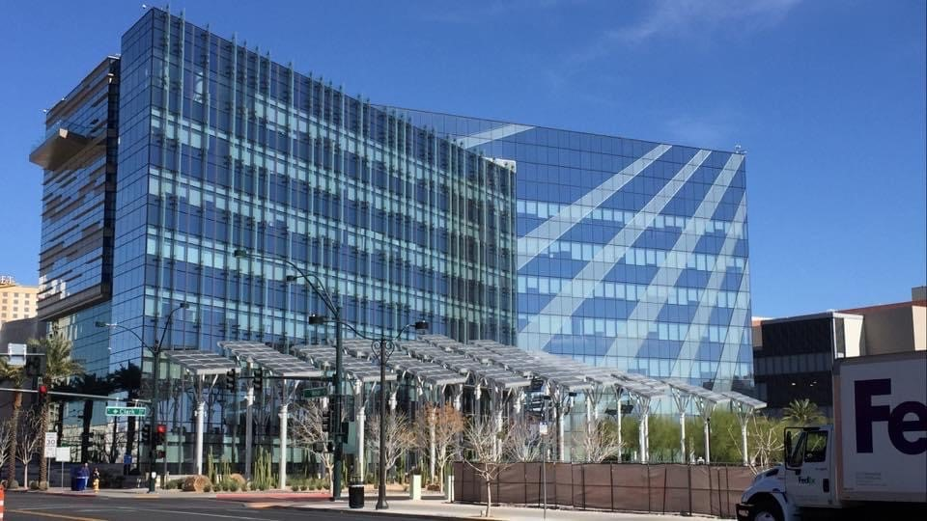
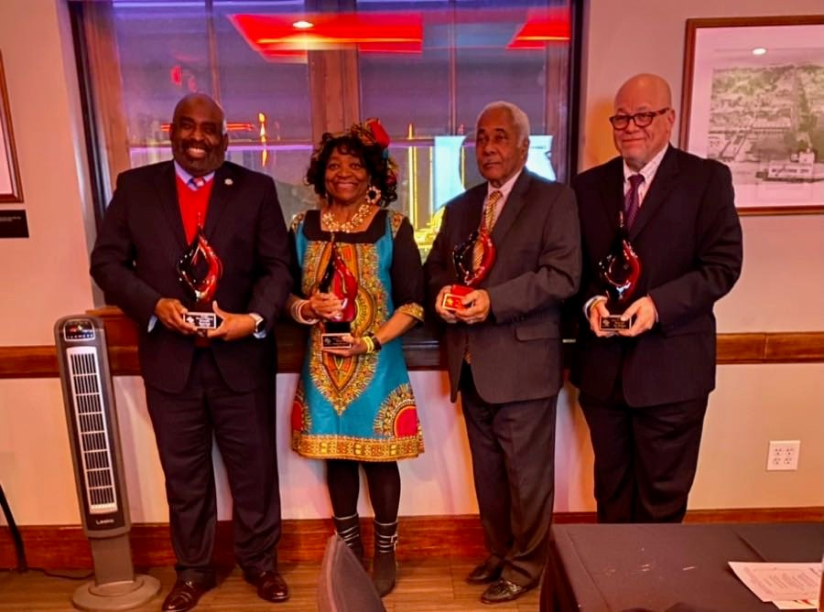
WHY I USE SOCIAL MEDIA
Personal
Keep up with Friends and Family
To find tenants and service providers for my rentals
For fun – post recipes, cooking, gardening, humor
Parties
Openings of various Friends’ businesses
Professional
Promote myself/My Office/My City/Events/Business
CLE panels I’ve participated on
Diversity, Equity and Inclusion efforts
Current office culture and happenings
Speeches and Keynote address I’ve given
Published articles I’ve authored
Honors I’ve received

Slide 8
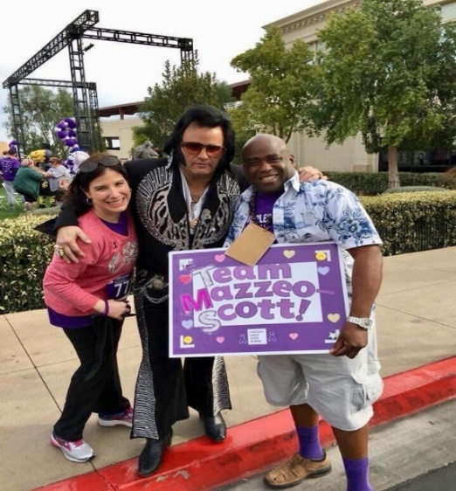
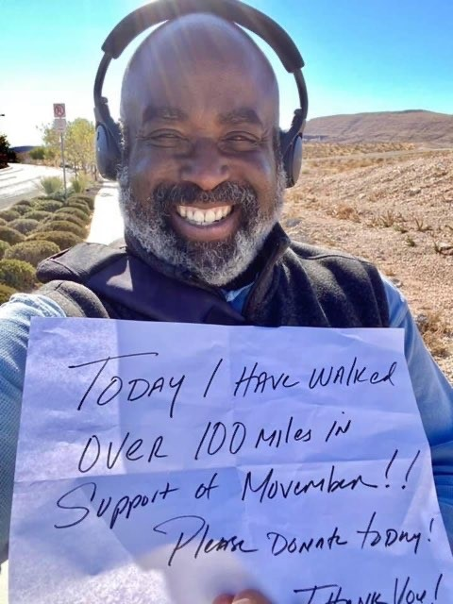
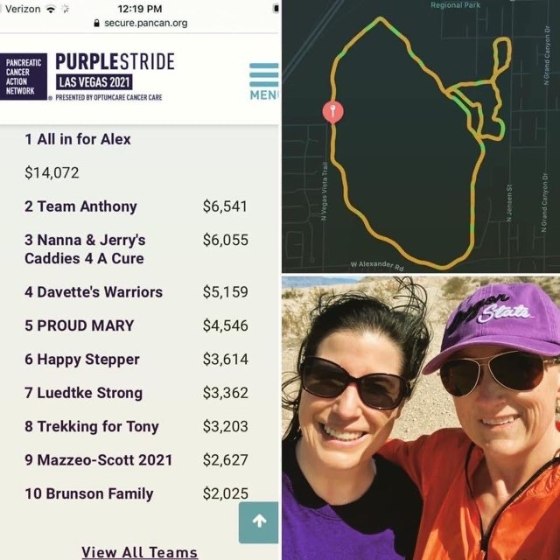
WHY I USE SOCIAL MEDIA
Invite people to various events:
Mock Trial Events
Parties
City Events
Openings of various Friends’ businesses
Fundraising: I have raised tens of thousands of dollars for various non-profit causes:
Movember – Prostate cancer and Men’s physical and mental health
Southern Nevada Senior Law Program - $3,200 birthday donations (2022), $1,470 birthday donation (2021)
Purple Stride Pancreatic Cancer Walk – Cathy Mazzeo and I raised over $10,000 with Team Mazzeo-Scott over the past several years.
Helping Hands Christmas fundraiser for Veterans Village

Slide 9
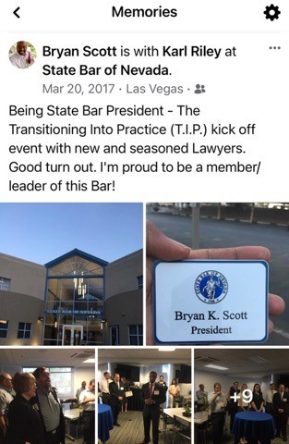
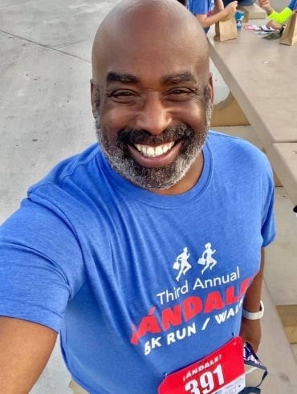
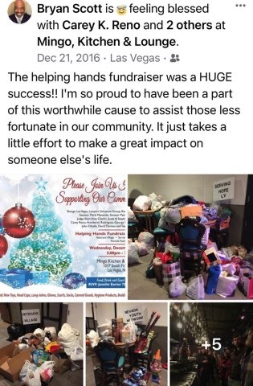
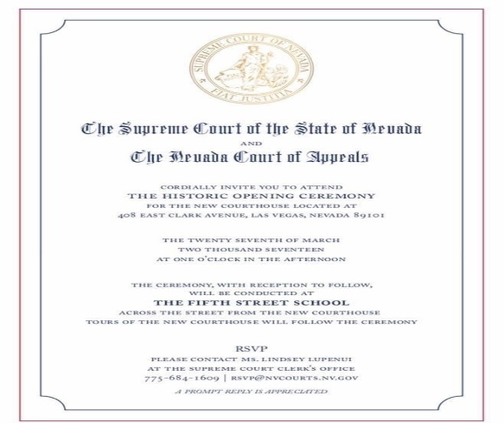
WHY I USE SOCIAL MEDIA
To promote the fundraisers/Causes of others:
The Justice Michael L. Douglas PreLaw Foundation
The Las Vegas Chapter of the National Bar Association Scholarship Gala
Asian American Advocacy Clinic Annual Fundraiser
Andale! 5k Run/Walk
Judicial Candidate fundraisers
Project 150
Recognized notable people/accomplishments:
State Bar of Nevada events
Courthouse(s) construction and openings
New Bar Building search, construction and opening
Historical purposes – an excellent way to store and search for photos, videos and create a historical reference (searchable)

Slide 10
HOW TO EFFECTIVELY USE SOCIAL MEDIA POSTS
Use it
Use it often – be consistent
Know how to use the various platforms SBN is using (they are different) – IG does not allow imbedded hyperlinks in the description, Facebook and LinkedIn do.
Have an audience. SBN has very few followers – build friendships and followers. Friend members and ask members to tag SBN and to pass on SBN posts, use hashtags and ask members to tag SBN
Interesting content – not just memes, but videos, photos of events. Use images, graphics and videos to tell a story where possible. Visual content is more engaging, and can often tell the story quicker and more succinctly than words alone.
In fact, an image or video can often stand alone in social media posts while still conveying the full message to your audience. Especially when it comes to Annual Meeting. On your site visits take videos and photos of the prospective area(s) where the conference will be held.

Slide 11
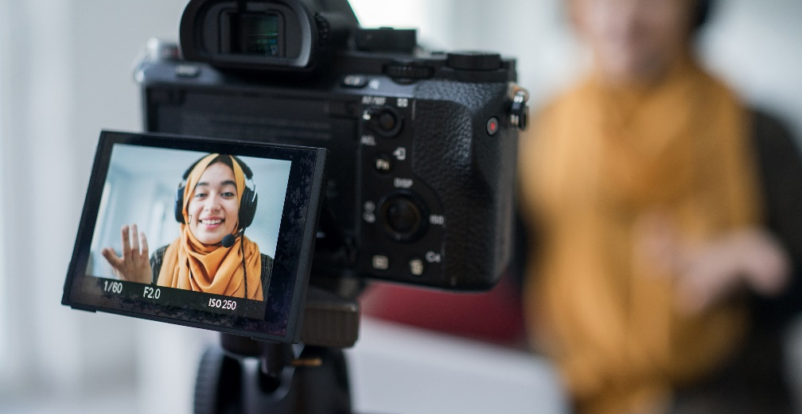
HOW TO EFFECTIVELY USE SOCIAL MEDIA POSTS
Make the page more active and dynamic – right now it’s very static
Use humor!
Make it personal – Especially when asking for money $$$$
Tell a story that engages and makes the reader feel like they are there. Like with cooking – take photos of each stage of the food preparation and the final result.
Use the proper messaging and platforms for the audience you are trying to reach. Younger Bar members may not use Facebook and Instagram. They are more into Tick Tock, YouTube and other newer platforms

Slide 12
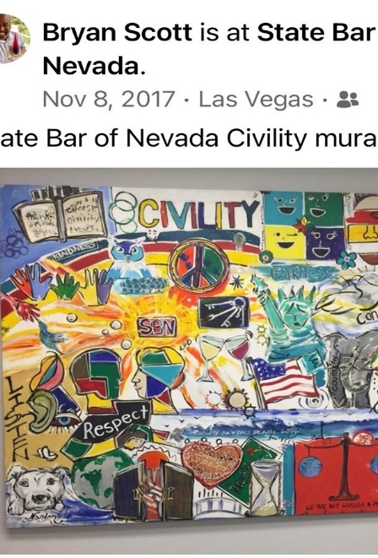
HOW TO EFFECTIVELY USE SOCIAL MEDIA
Respond to comments or like posted comments
Talk about the BOG and what it does, Highlight BOG members, Bar Services and how you can help the followers and the professionals
Highlight fun activities and what the bar is doing with members money
Wellness topics
Add a free CLE to the social media page with a 10 question test
Highlight the meeting with the Supreme Court, any ADKT Hearings, etc.
If you deem social media worthwhile, hire a social media person to run the sites.

Slide 13
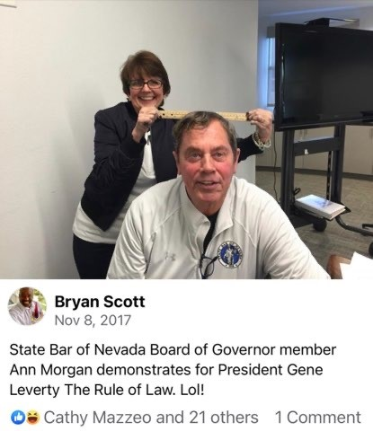
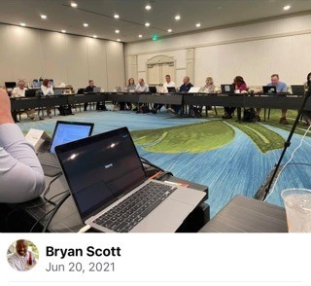
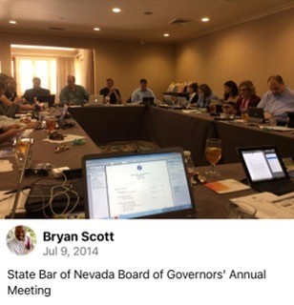
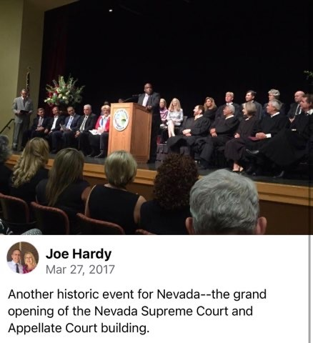
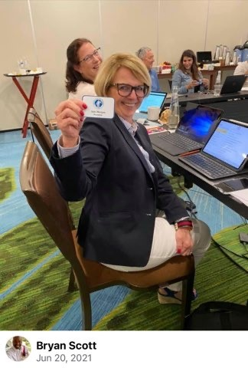
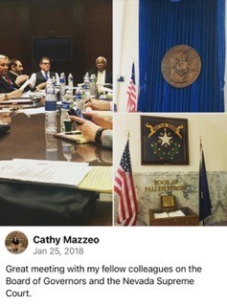
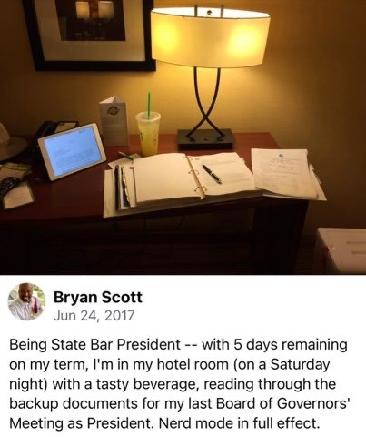
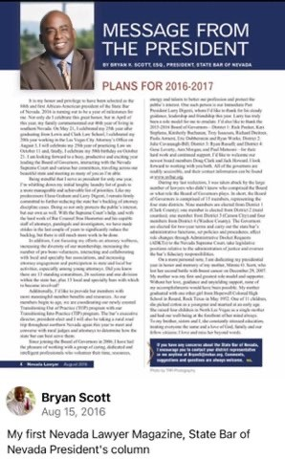
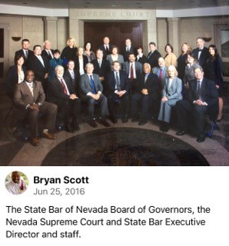
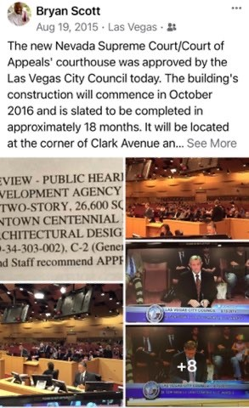

Slide 14
IN CONCLUSION:
Magazines and printed media are going by way of the dinosaur.
Other than the President’s column and the discipline section, I can’t tell you the last time I had time to read the Nevada Lawyer Magazine or the Communique’.
Newer members will expect to receive their news from the Bar in new and innovative ways.
The Bar will need to adapt more quickly than it has in order to communicate efficiently and effectively with its members.

